Slide 1
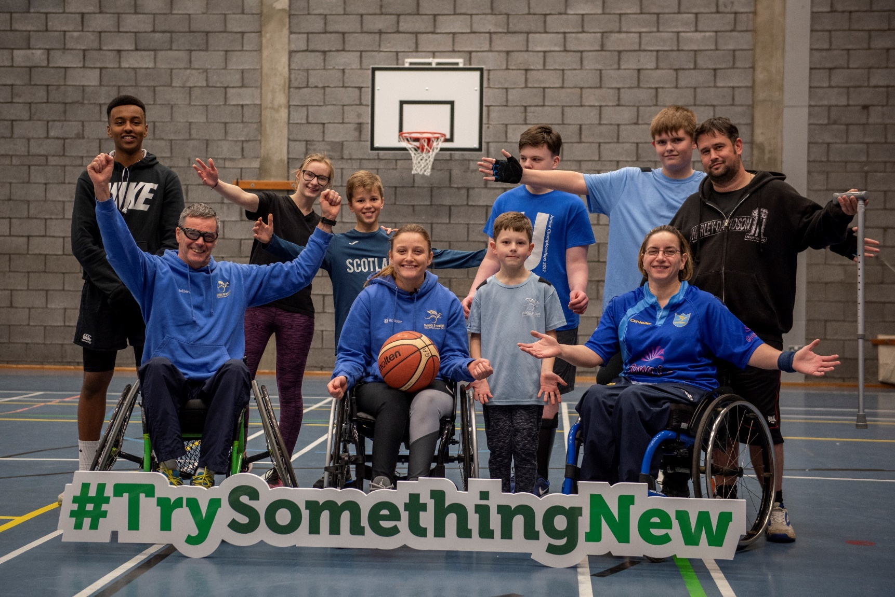
ILF Scotland Transition Fund

Slide 2
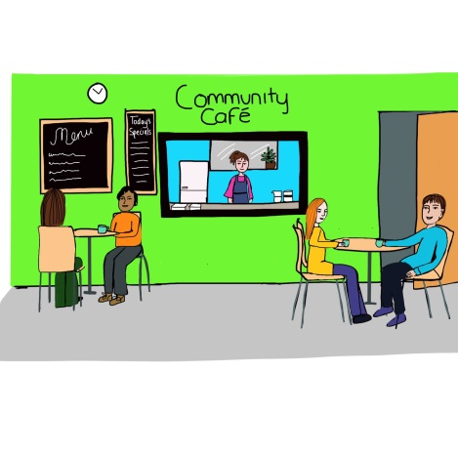
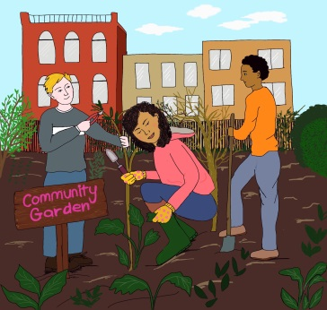
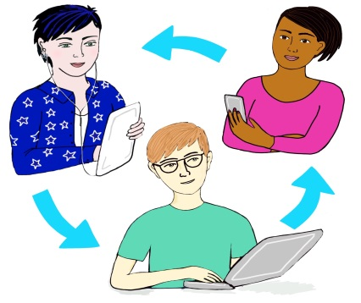
What is the ILF Scotland Transition Fund?
The ILF Scotland Transition Fund provides money, for up to one year, to support young disabled people aged 16-25, who are at an important transitional stage in their lives.
The overarching purpose of the fund is to enable young disabled people to become more engaged and active in their communities.

Slide 3
Who can apply?
You can apply for the ILF Scotland Transition Fund if you:
Are between the age of 15 and 25 years old
Are “resident and present” in Scotland at the time of application and intend to remain for the grant period
Have an impairment or disability (as defined in the Equality Act 2010).
Have less than £28,500 of personal savings.
Although the Fund is not exclusive to people who receive little or no social work support, they will be prioritised.

Slide 4
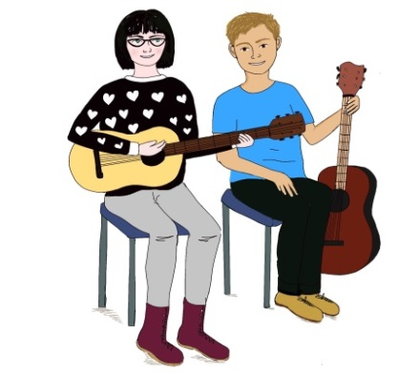
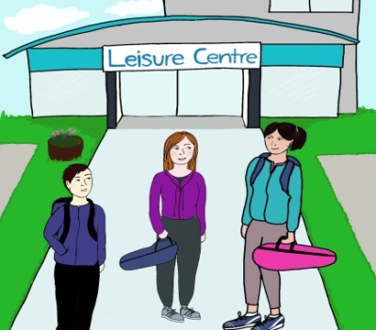
What can the money be used for?
#trysomethingnew
You can use the money for things like:
art or music lessons or sports coaching
a device or piece of technology to help you in your transition
travel training,
to join a class and/or club,
driving lessons,
training courses.

Slide 5
Limits on using the money
Money from the ILF Transition Fund cannot be used to fund;
Personal care
Medical care
Supervision
Essential safeguarding/adult support and protection
Communication aids
Aids and adaptations
Home improvements
Accommodation costs
Day to day living expenses
Clothing (unless it is specifically required for an activity)
Holidays

Slide 6
Examples of what we cannot/will not fund
Any item or service that is the responsibility of another statutory body (Local Authority/NHS/SAAS/Business Gateway etc)
Vehicles* and vehicle insurance
Routine Travel
Any outcome that does not have a community involvement element (eg, items solely for home use without any link to a community outcome)
This list is not exhaustive

Slide 7
Key Points
The maximum amount you can request is £4000 (from 1st April 2021)
If you need a single disability related item above £4000 (specialist wheelchair/adapted Tech etc) we can consider this on an individual basis
You need to identify what you hope to achieve with the grant (your outcome) and anything you request needs to be related to that
You can only have one successful application in any 12 month period (but you can apply as many times as you need to be successful)
Applications for items for solo use at home with no community activity element are unlikely to succeed
You can reapply after the end of your grant period to meet a new a new outcome (we prioritise 1st time applications)

Slide 8
Think about…
Tell us about your disability or impairment – What effect does it have on how you live your life?
We will need proof of disability or impairment- either a DLA or PIP award letter or a letter from a professional that knows you well enough to tell us how your disability affects you day to day.
We need a quote for each item you request- either on headed paper or via an internet link so that we can fully assess your application
The application should be for something new and not something that is already being paid for from another source.
If your application is successful, please ensure that you return your agreement form with Photo ID and something confirming your address (an official letter, bank statement or similar).

Slide 9
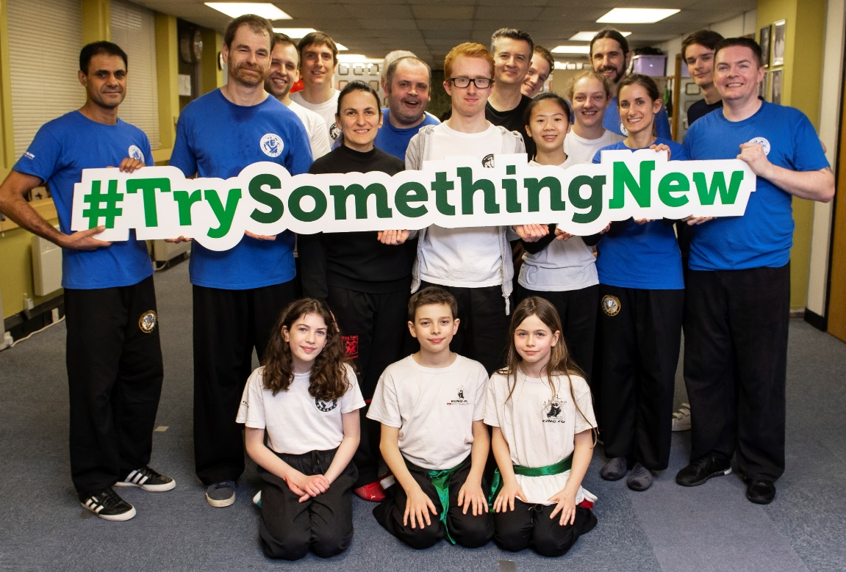
Young Person’s Planning Grant
Not sure what to apply for but want to participate in your community and continue to spend time with other people?
ILF Scotland can provide person centred planning grants up to £650 to help young people find the
support they need
to plan their future and
make and application
to the Transition Fund.

Slide 10
Hints and Tips
To complete your application you will need:
your national insurance number,
your local authority area,
your Disability Living Allowance (DLA) or Personal Independence Payment (PIP) benefits letter if you receive this, or
A letter from a professional who can confirm your disability.
Before you start your application you should also
think about these things:
What is your goal?
How will your goal benefit you?
What financial support do you need to reach your goal?
Who will support you to reach your goal?

Slide 11
How can I apply?
Online
By going to the ILF website and entering your email address in the box at https://ilf.scot/transition-fund/how-can-i-apply/ and clicking on apply now– this is the easiest and fastest method to apply. Supporting workers can now use one email to assist multiple young people to apply. This is our preferred option and the quickest way to get a response.
Email
You can apply by going on our website www.ilf.scot and downloading the application form, filling it in and emailing it to us at enquiries@ILF.scot
Post
If you cannot access our website, you can phone us on 0300 200 2022 and ask us to send you an application form.

Slide 12
Contact us
Facebook/IndependentLivingFundScotland
@ILFScotland
#trysomethingnew
Enquiries@ILF.scot
0300 200 2022

