Slide 1
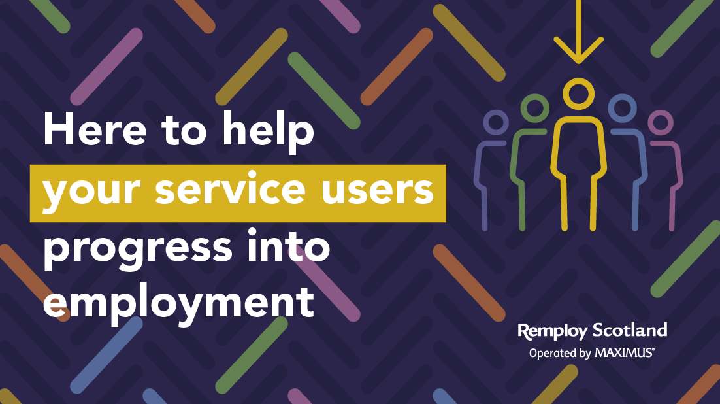

Slide 2
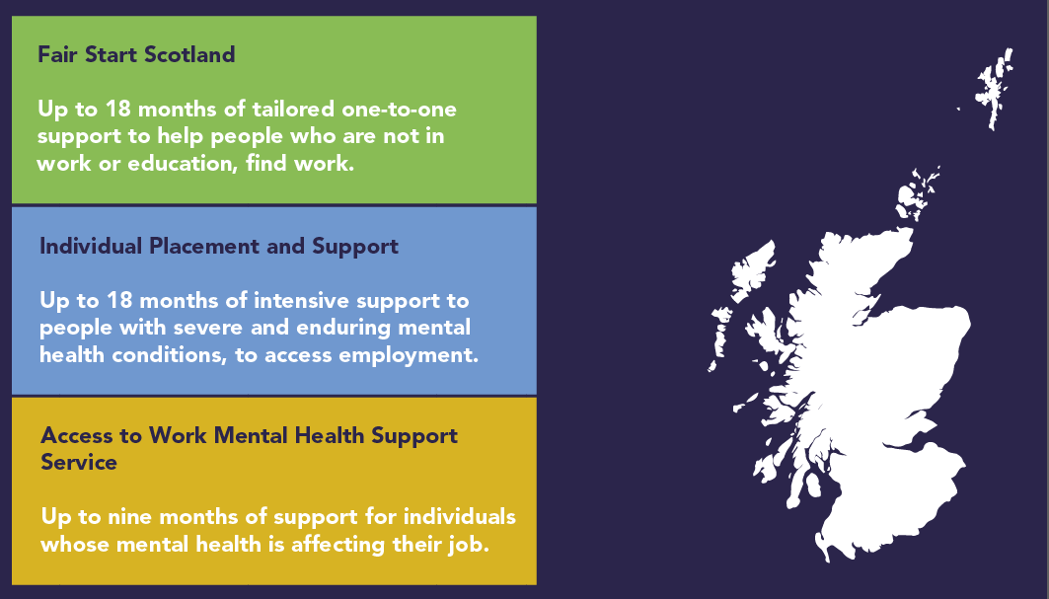
Can I apply?
Our employment programmes cover Lanarkshire and Tayside and our mental health wellbeing programme covers all of Scotland.

Slide 3
Remploy & Fair Start Scotland

Slide 4
We’ve already helped thousands of people. Here’s what our participants told us:
During the pandemic, my anxiety levels were affected. Thanks to the calls from my Key Worker, my barriers began to break down, my confidence increased and I felt I could get back into work.
John

Slide 5
We’ve already helped thousands of people.
Here’s what our participants told us:
Being made redundant was a major blow. Remploy provided a beacon of light in a dark time. They’ve been pivotal in improving my mental health and finding work again. Becky

Slide 6
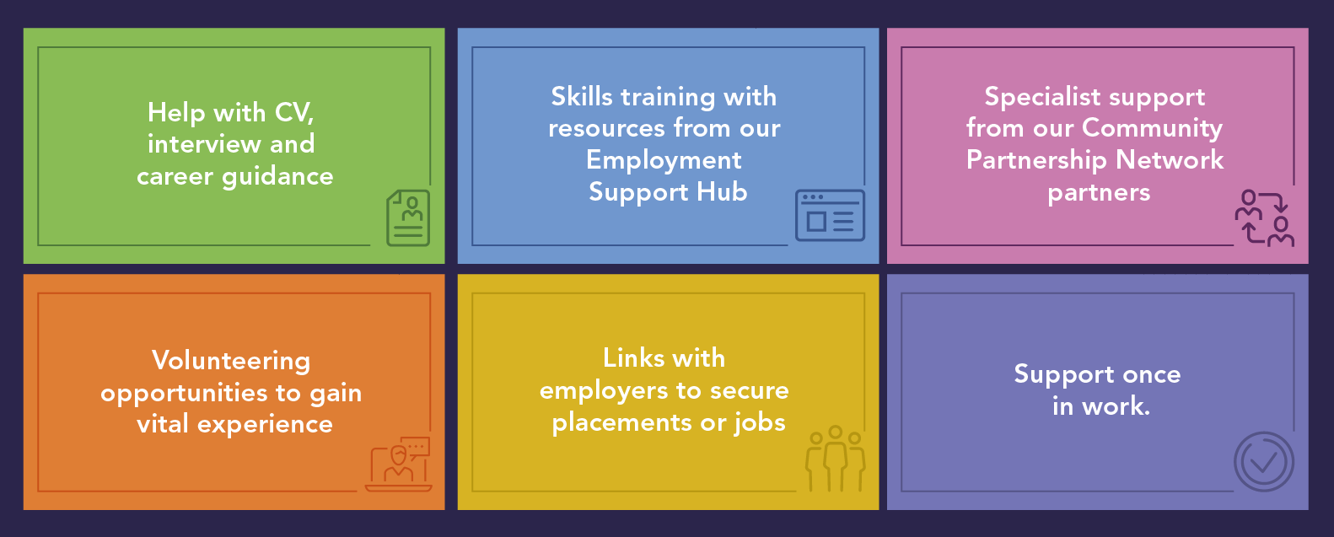
Participants will benefit from:

Slide 7
Here’s a preview of the Employment Support Hub
Remploy Employment Support Hub

Slide 8
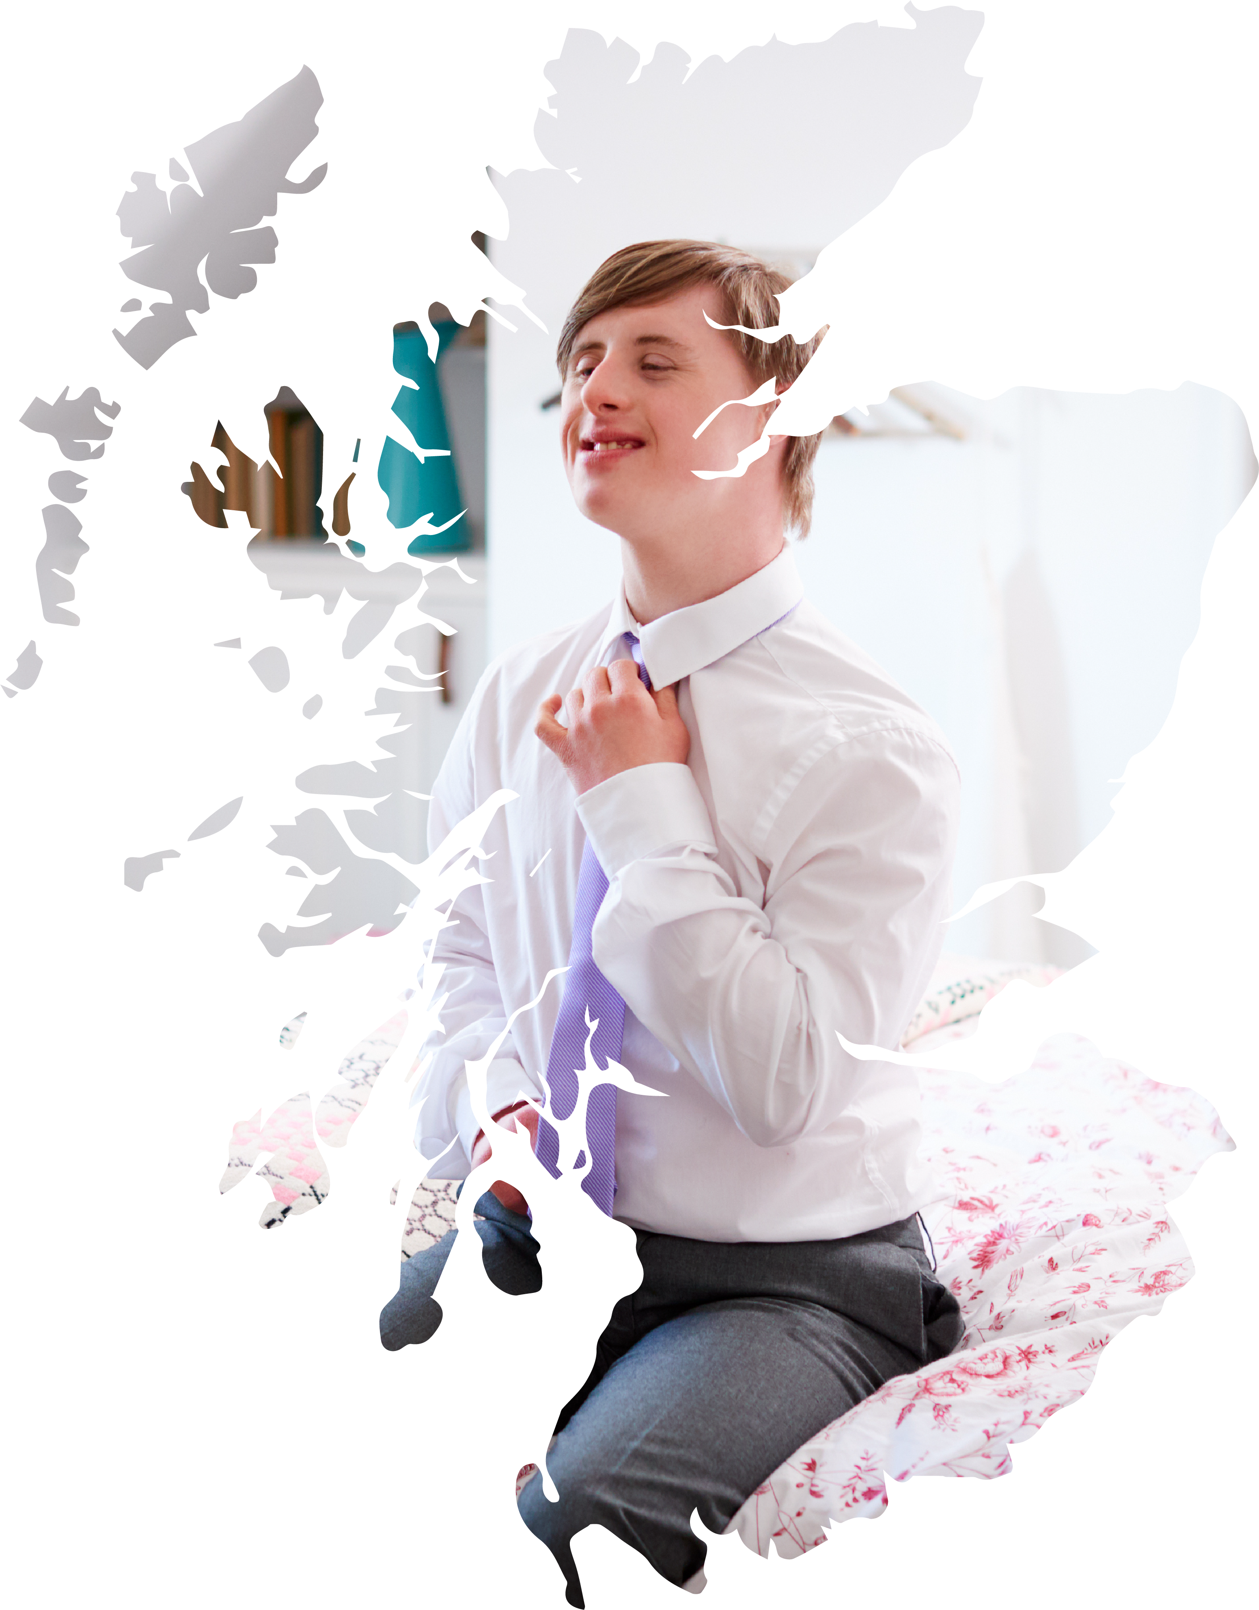
Our Community Partnership Network
We partner with more than 100 public, private and third sector organisations, to ensure more disabled and disadvantaged people are supported into sustainable employment.
Our CPN partners provide individualised and tailored support to participants who need extra interventions, for example, access to digital equipment, housing and debt advice or mental health support. We work together to ensure that all individuals in Scotland have every chance to succeed and benefits from the support they need to gain and retain employment.

Slide 9
Here’s what participants said about our support…
I managed to attain my CSCS card which has opened up many opportunities in Construction. I am still job searching but this is a massive step in the right direction. Craig

Slide 10
Here’s what participants said about our support…
Remploy really helped my confidence. Accessing the Digital College enabled me to achieve my Manual Handling certificate and get a new career in care.
Moira

Slide 11
Why partner with us? Our CPN partners tell us:

Slide 12
Our Partnership team
Theresa Devenney Engagement Key Worker
North Lanarkshire
07760 171413
theresa.devenney@remploy.co.uk
Peita-Anne Paterson
Partnership Manager
Scotland
07765 897023
peita-anne.paterson@remploy.co.uk

Slide 13
We’re the recruitment partner of choice
Here are just a few of the employers we work with:

Slide 14
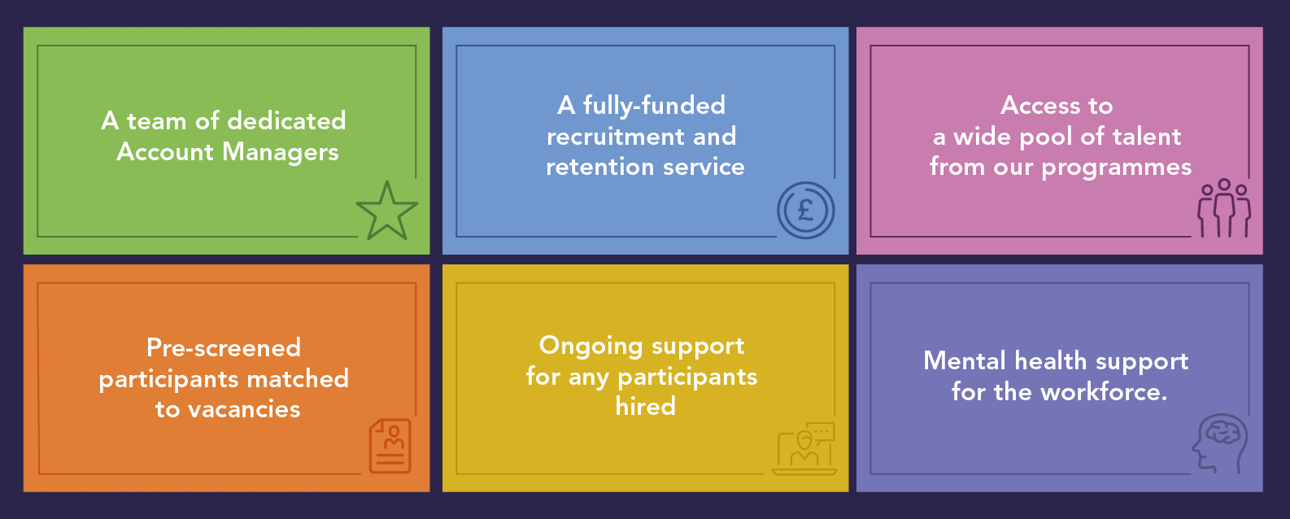
We provide:

Slide 15
Why choose us? Our employer partners tell us…

Slide 16
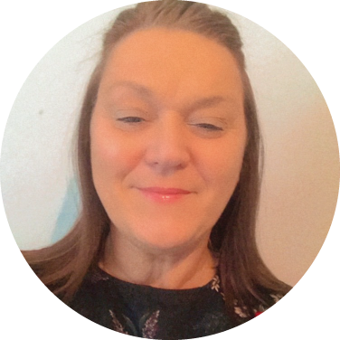
Meet our Regional Account Managers in North and South Lanarkshire
TBC
Regional Account Manager
North Lanarkshire
Sharon Doonan
Regional Account Manager
South Lanarkshire
07795 618154
sharon.doonan@remploy.co.uk

Slide 17
Our support doesn’t stop there…
Once in work, our In Work Support can help participants with any barriers they may face including:
Managing
your money
Assistance with travel
Workplace adjustments

Slide 18
Feedback from our In Work Support service…
I got a role working on the COVID Helpline during the pandemic. It was stressful at times but Remploy’s In Work Support allowed me to vent my frustrations and anxieties. They were always there with advice and support.
John

Slide 19
Feedback from our In Work Support service…
Thank you for all your help with everything. I don’t know where I would be without Remploy. Thank you very much. Callum

Slide 20
Additional support services
Access to Work Mental Health Support Service
Access to Work Mental Health

Slide 21
Thank you

